Slide 1
EMPLOYEES BURNOUT ANALYSIS AND PREDICTION
CAPSTONE PROJECT
Presented By:
Sahil Rajesh Bhure D.Y. Patil College of Engineering Pune
(Computer Engineering)

Slide 2
OUTLINE
Problem Statement
System Development Approach
Algorithm & Deployment
Result
Conclusion
Future Scope
References

Slide 3
Problem Statement
Overview:
Employee burnout is a critical issue affecting productivity, morale, and overall well-being.
Prolonged stress, workload imbalance, and lack of support are major contributors.
Organizations need a reliable system to predict and mitigate burnout risks.
Objective:
Build a machine learning model to predict the burnout rate based on key employee factors.
Enable timely interventions for at-risk employees through data-driven insights.
Significance:
Promotes employee satisfaction, reduces turnover, and enhances workplace efficiency.

Slide 4
System Approach
System Requirements
Hardware:
Minimum: Laptop/PC with 8GB RAM, Intel i5 Processor, 500GB Storage.
Recommended: 16GB RAM, GPU for faster processing.
Software:
Python 3.8+.
Flask for application devlopment.
Jupyter Notebook for exploratory data analysis (EDA).
Libraries Required to Build the Model
Data Analysis & Processing:
Pandas
NumPy
Visualization:
Matplotlib
Seaborn
Machine Learning:
Scikit-learn
XGBoost

Slide 5
Algorithm & Deployment
Data Collection:
Gather relevant employee data (work hours, job role, stress levels, performance metrics, etc.).
Data Preprocessing:
Handle missing values, outliers, and encode categorical variables.
Normalize/standardize features as required.
Exploratory Data Analysis (EDA):
Visualize relationships between features and burnout rates.
Identify key predictors using correlation analysis.
Feature Selection:
Select features contributing significantly to burnout rate prediction.

Slide 6
Model Development:
Train machine learning models (e.g., Random Forest, Linear Regression) on the dataset.
Use cross-validation to optimize hyperparameters.
Model Evaluation:
Evaluate model performance using metrics like RMSE, R^2, and accuracy.
Deployment:
Integrate the model into a Flask application.
Create a user-friendly interface with templates and static files.

Slide 7
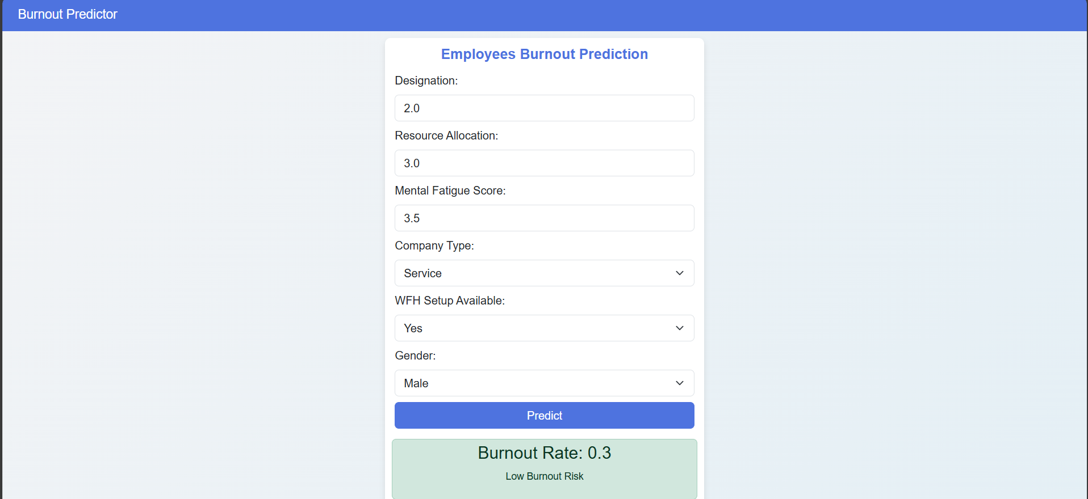
Result

Slide 8
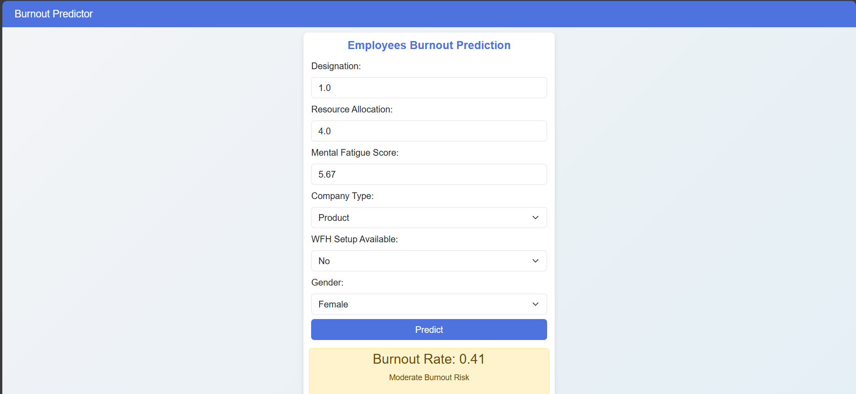

Slide 9
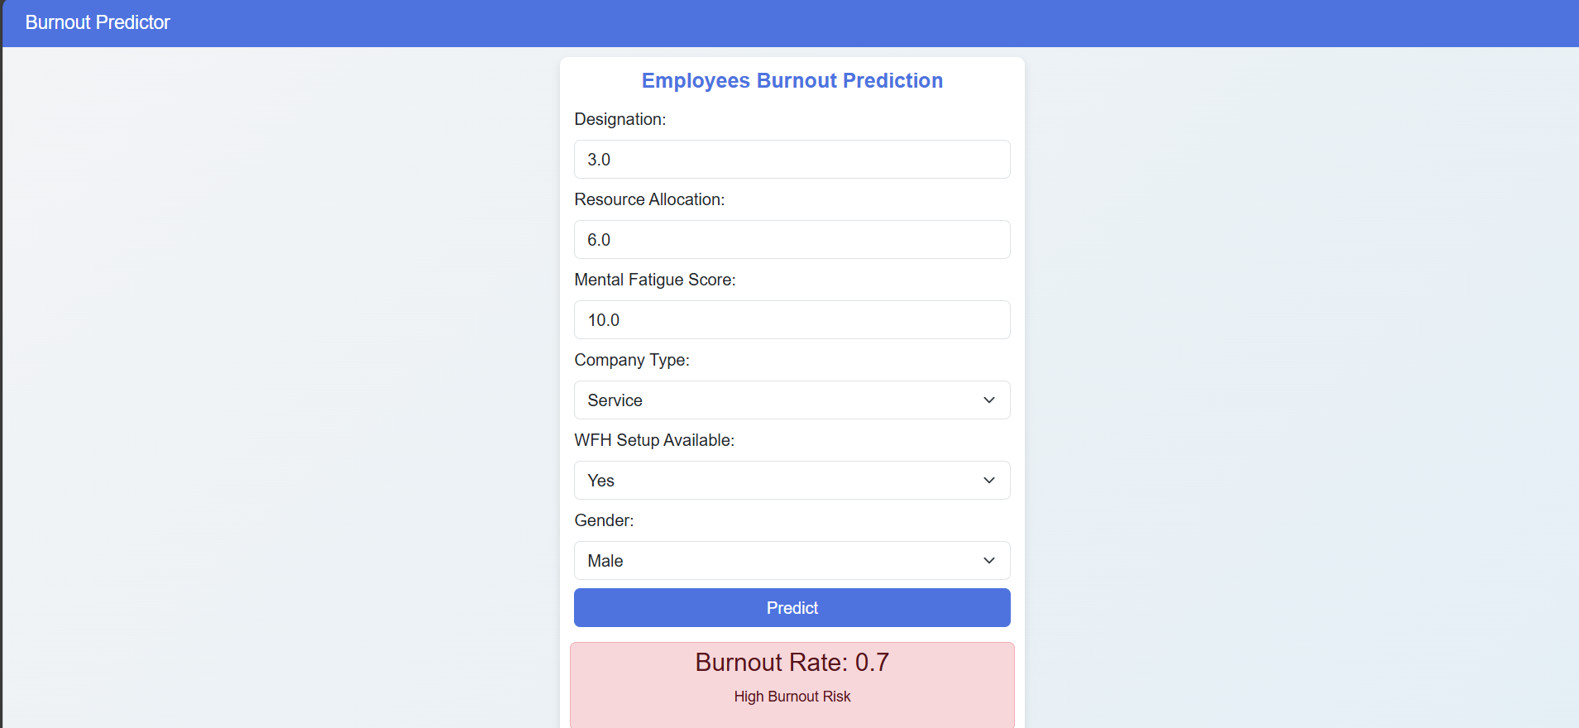
Github Link: https://github.com/sahil1021/employee_burnout_prediction

Slide 10
Conclusion
Key Findings:
Successfully predicted employee burnout rates using linear regression with below evaluation metrices score:
Mean Squared Error: 0.0031
Root Mean Squared Error: 0.0561
Mean Absolute Error: 0.0459
R-squared Score: 0.9188
Effectiveness:
Model provides reliable predictions, enabling proactive interventions.
Improvements:
Include more diverse datasets to enhance generalizability.

Slide 11
Future scope(Optional)
Integration with HR Systems: Automate data collection and reporting for real-time burnout monitoring.
Advanced Features: Incorporate Natural Language Processing (NLP) to analyze employee feedback and stress levels.
Scalability: Expand the system to handle larger organizations and diverse industries.
Predictive Interventions: Suggest personalized recommendations based on prediction results.

Slide 12
THANK YOU

